Slide 1

Enhancing Stock Price Prediction for Nifty 50 IT Sector Companies: A Comparative Study of ML Models with Event Data Integration Economics and Finance
Third Review
Course Code: CS7510
Course Title: Project 1
24MSP3038
Aniket Shinde
13/12/2024

Slide 2
Abstract
This study addresses the challenge of predicting stock prices in the volatile IT sector of the Nifty 50 index, where traditional models based solely on historical data often fail to account for influential market events, such as economic policy shifts, earnings reports, and global economic changes. By incorporating event-driven data into predictive models, this research aims to improve the accuracy of stock price forecasting for IT companies, providing a more responsive tool for market analysis. Specifically, we evaluate the performance of ARIMA, SARIMA, GRU, and LSTM models. The comparative analysis of these models across multiple performance metrics highlights the potential of event-enhanced LSTM models, demonstrating lower error rates and improved accuracy over baseline approaches. The findings contribute to existing financial literature by demonstrating how integrating external events can significantly improve stock forecasting accuracy. This study holds practical value for investors, analysts, and financial institutions, supporting more robust decision-making in high-volatility markets and setting a foundation for applying this predictive approach across other sectors.

Slide 3
Introduction
Stock price prediction, particularly in the Nifty 50 IT sector, is a challenging task due to the high volatility of financial markets and the profound impact of market-moving events. This problem is critical for investors, analysts, and policymakers aiming to make informed decisions in a dynamic and competitive environment. While traditional models like ARIMA and SARIMA have been widely used for time series forecasting, emerging techniques such as GRU and LSTM have shown promise in capturing complex temporal patterns. Moreover, prior research has rarely integrated event-driven data into stock price prediction frameworks, leaving a gap in fully leveraging external factors that influence market movements.
To address these challenges, we propose a comprehensive approach combining advanced machine learning models and event data integration for enhanced predictive accuracy. Our contributions include a comparative study of traditional and deep learning models and a novel integration of event-driven insights into the forecasting process. By utilizing all available features to their fullest extent, this research aims to provide actionable insights and improve forecasting precision in the IT sector, which holds significant importance in the Indian financial landscape.

Slide 4
Need of study
The Nifty 50 IT sector, a vital component of the Indian economy, faces challenges in accurate stock price prediction due to high volatility and the impact of external events. Existing models often fall short in capturing the nuanced influence of these factors.
This study addresses this gap by combining advanced machine learning with event-driven insights. By analyzing the impact of external events, we aim to improve forecasting accuracy, empower informed decision-making, and contribute to a deeper understanding of market dynamics. Additionally, this study will demonstrate the advantage of Recurrent Neural Networks (RNNs) like GRU and LSTM in effectively capturing complex market movements and temporal dependencies.

Slide 5
Problem Statement
Predicting stock prices in the Nifty 50 IT sector is challenging due to high volatility and the impact of market-moving events, making it necessary to use models that integrate event-driven data for improved accuracy

Slide 6
Objectives
This study aims to develop a robust predictive framework for stock price forecasting in the Nifty 50 IT sector by leveraging machine learning models and event-driven data. The primary focus is on stock prices as the dependent variable, with predictors including daily returns, trading volume, and event-driven data such as economic announcements and global news. By implementing and comparing ARIMA, SARIMA, GRU, and LSTM models, the study seeks to assess predictive accuracy and demonstrate the advantage of RNNs in capturing complex market movements influenced by external factors.
The scope includes analyzing stock performance from 2006 to the present, focusing on major IT companies within the Nifty 50. The study identifies significant external events contributing to market fluctuations and evaluates model performance using metrics like RMSE, MAPE, and R-squared. To maintain clarity, the study avoids redundant variables and excludes minor events with negligible impact, ensuring that only strictly necessary data is considered. This approach systematically addresses the research problem while providing actionable insights into market dynamics.

Slide 7
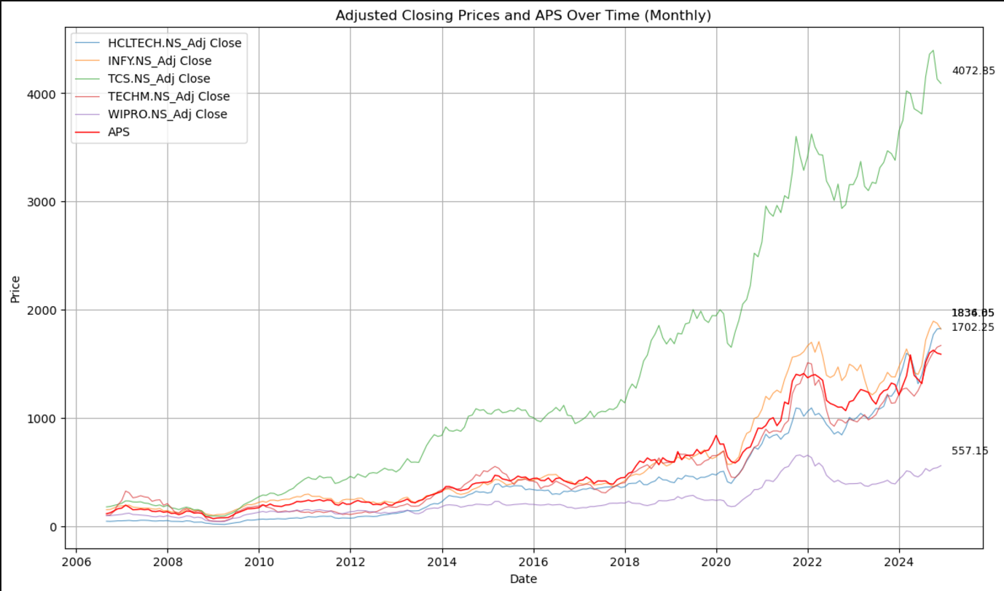
Exploratory Data Analysis
The time series plot shows an overall upward trend in the adjusted closing prices of major Indian IT companies, with significant growth after 2020 and notable divergence between companies. Key events include a dip during the 2008 financial crisis and a sharp drop and recovery during the COVID-19 pandemic.

Slide 8
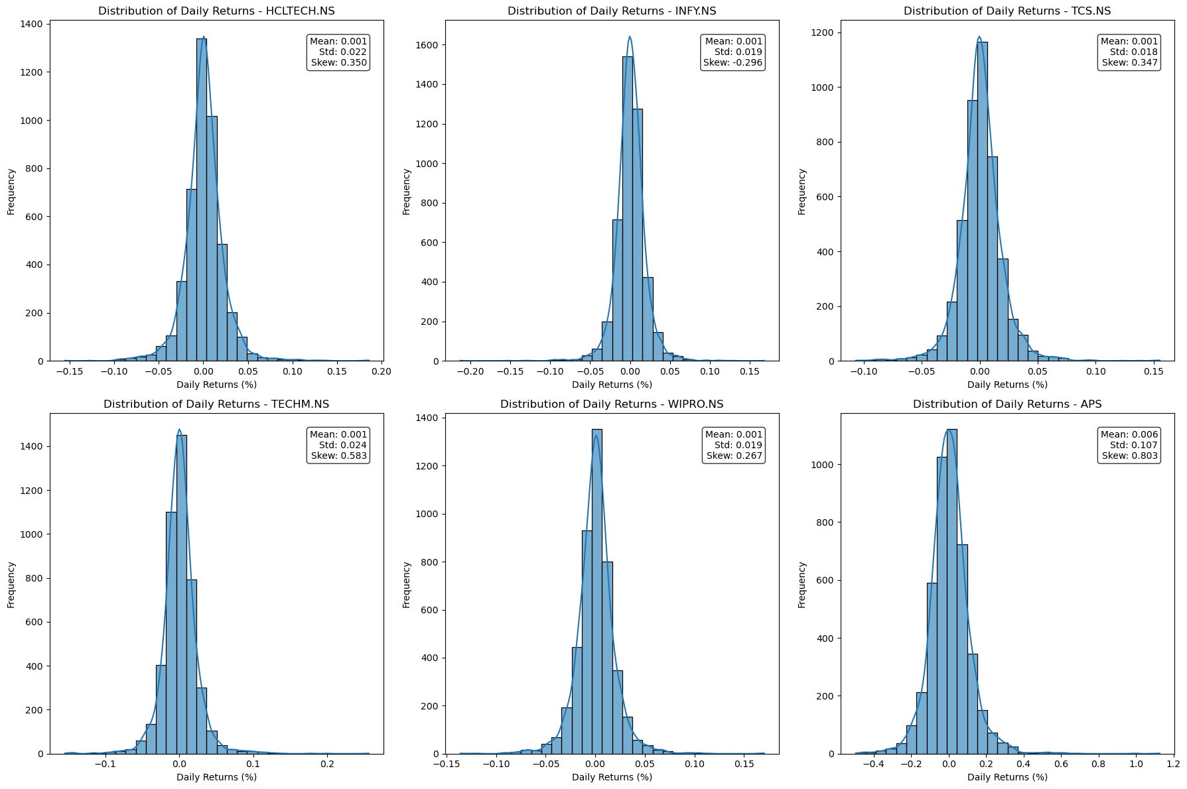
Exploratory Data Analysis (cont.)
The histograms of daily returns for all stocks show a bell-shaped distribution centered near zero, indicating that small daily price changes are most common, with rare extreme movements.

Slide 9
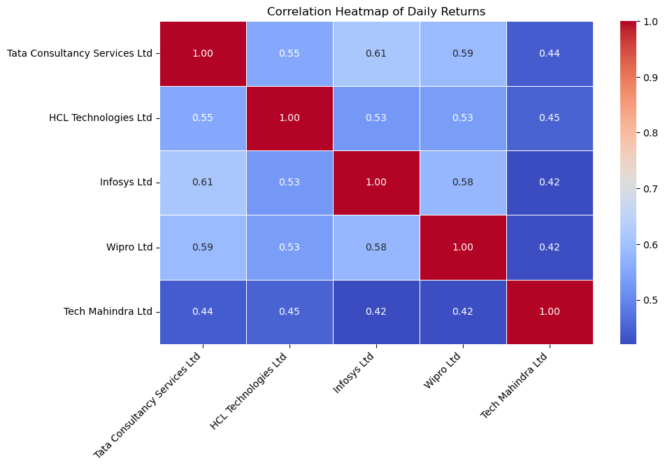
Exploratory Data Analysis (cont.)
The correlation matrix shows moderate to strong positive relationships between the stocks of major Indian IT companies, with Infosys and Tata Consultancy Services exhibiting the highest correlation at 0.61.

Slide 10
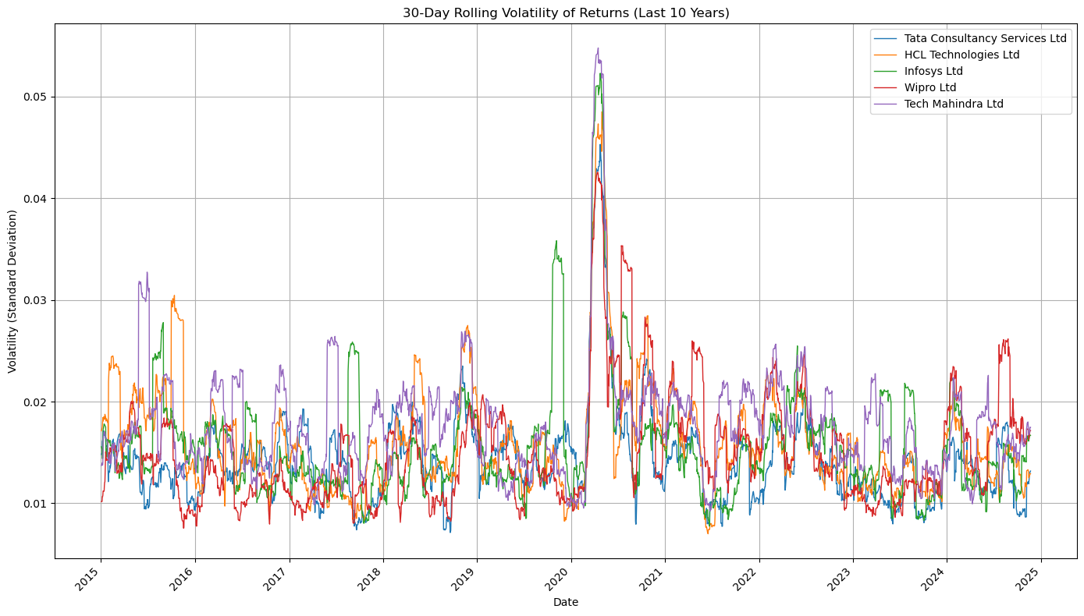
Exploratory Data Analysis (cont.)
This 30-day rolling volatility plot highlights the uncertainty in the stock market around the time of the COVID-19 pandemic lockdowns.

Slide 11
Related Work
S.No. | Title of the Paper | Authors | Journal Name/Conference Title & Publisher | Year of Publication | Methodology used | Performance of the proposed algorithm | Limitations of the Research | Future approach if any
1. | Sentiment-driven predictive models for Nifty 50 stock market fluctuations: A time series analysis perspective | Mohan, B., Yadav, A., Toleti, J., Reddy, D. S. S., Ahmed, R. K., & Koushitha, G. | IEEE International Conference on Information Technology, Electronics and Intelligent Communication Systems (ICITEICS) | 2024 | ARIMA, SARIMAX, LSTM, and XGBoost with sentiment-driven time-series data integration | LSTM demonstrated effective price prediction with 24.4 MSE and RMSE 4.9 | Inherent unpredictability of stock prices due to external factors like news and economic indicators | Future directions include exploring hybrid models, enhancing feature engineering, and integrating real-time data processing

Slide 12
Related Work
S.No. | Title of the Paper | Authors | Journal Name/Conference Title & Publisher | Year of Publication | Methodology used | Performance of the proposed algorithm | Limitations of the Research | Future approach if any
2. | Comparative analysis of ARIMA and LSTM models for stock price prediction | Panchal, S. A., Ferdouse, L., & Sultana, A. | IEEE/ACIS 27th International Conference on Software Engineering, Artificial Intelligence, Networking and Parallel/Distributed Computing (SNPD) | 2024 | ARIMA and LSTM | LSTM outperformed ARIMA achieving lower RMSE values | ARIMA model struggled with non-linear patterns and sudden fluctuations compared to LSTM | N/A

Slide 13
Related Work
S.No. | Title of the Paper | Authors | Journal Name/Conference Title & Publisher | Year of Publication | Methodology used | Performance of the proposed algorithm | Limitations of the Research | Future approach if any
3. | Exploring the impact of financial news sentiment on stock price forecasting: A comparative deep learning approach | Rajhans, A., Das, T., Kumar, A., & Sinha, B. B. | 2024 1st International Conference on Communications and Computer Science (InCCCS) | 2024 | LSTM, GRU, CNN, and a hybrid LSTM-GRU model using NSE stock data | CNN model showed the best performance with the lowest RMSE for two stocks while the LSTM-GRU hybrid model performed best for TCS, highlighting CNN's overall robustness for stock prediction​ | Study was limited by the one-year dataset used, which may impact the model's ability to generalize to longer periods or different market conditions | Could explore reinforcement learning integration, alternative feature selection methods, and application on larger or real-time datasets

Slide 14
Related Work
S.No. | Title of the Paper | Authors | Journal Name/Conference Title & Publisher | Year of Publication | Methodology used | Performance of the proposed algorithm | Limitations of the Research | Future approach if any
4. | A study of LSTM optimisation for forecasting volatile time series data | Taslim, D. G., Tjahyadi, H., & Murwantara, I. M. | 2024 4th International Conference on Computer Communication and Artificial Intelligence (CCAI) | 2024 | LSTM hyperparameter optimization, focusing on the effects of epochs, units, and optimizers (SGDM, Adam, and RMSProp) on forecasting volatile time series data | Optimized LSTM with SGDM achieved the lowest RMSE of 0.51, significantly improving prediction accuracy with increased epochs | The study was limited by the use of a single volatile dataset and inconclusive results regarding the impact of the number of units on accuracy | Testing additional hyperparameters, modifying LSTM cell structures, and evaluating the models on other non-linear datasets

Slide 15
Related Work
S.No. | Title of the Paper | Authors | Journal Name/Conference Title & Publisher | Year of Publication | Methodology used | Performance of the proposed algorithm | Limitations of the Research | Future approach if any
5. | Time-series-based stock market analysis using machine learning | Amruth, S. J., Nigelesh, T., Shruthik, V. S., Reddy, V. S., & Venugopalan, M. | 2024 15th International Conference on Computing Communication and Networking Technologies (ICCCNT) | 2024 | SVM, Logistic Regression, XGBoost, Naïve Bayes, Random Forest, and Gradient Boost, to analyze stock data | XGBoost and Gradient Boost emerged as top-performing models across various stocks | The study's reliance on real-time data makes it challenging to designate a singular best model, as performance varies depending on market conditions and stock-specific factors | Adding deep learning techniques and personalized features based on user portfolios to further enhance prediction accuracy and decision-making support

Slide 16
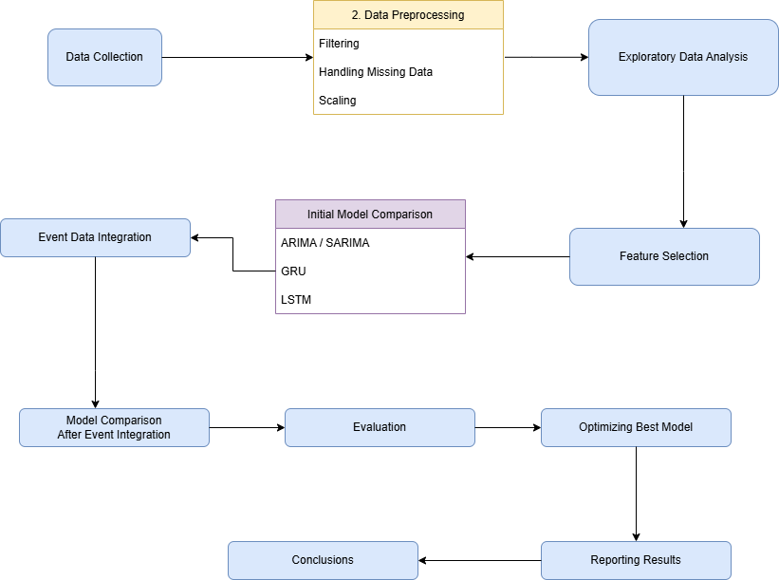
Proposed Methodology

Slide 17
Load the Dataset: Load data into the environment using the Yahoo Finance API
Data Cleaning : Clean data, handle missing values, fill in gaps in dates to ensure continuity, scale/normalize data, etc.
Visualization: Create visualizations to explore data patterns and relationships.
Model Selection: Choose appropriate machine learning models for prediction.
Model Training: Train the selected models on the transformed dataset.
Predictions: Make predictions on new or unseen data using the selected model.
Model Evaluation: Assess the performance of trained models using evaluation metrics.
Comparative Analysis: Compare the performance of multiple models.

Slide 18
Dataset
Source of the Dataset: Yahoo Finance API
No. of Observations: 5951 per company
Column/Feature Details: Date, Ticker, Open, Close, Adj Close, High, Low, Volume, APS, Gold Price, USD to INR, S&P 500
Details about the columns:
Date: Discrete (time-series feature)
Price-related columns (Adj Close, Close, High, Low, Open): Continuous
Volume: Discrete (countable values)

Slide 19
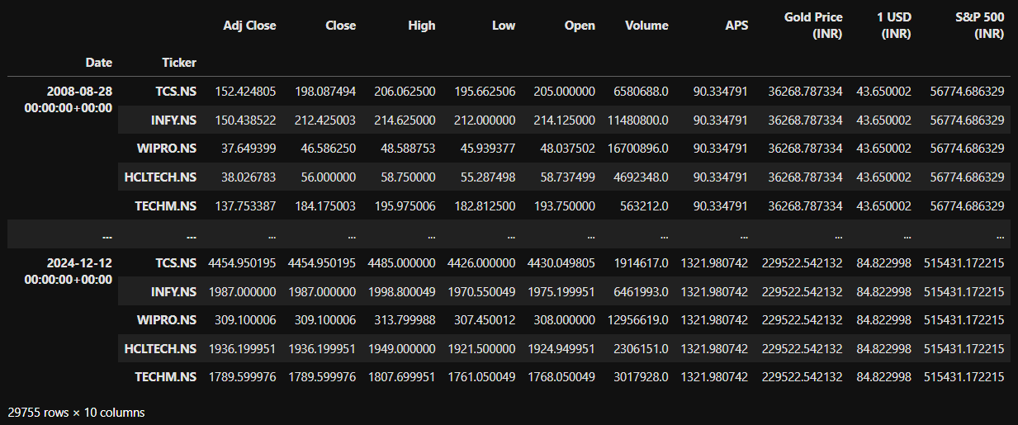
Dataset

Slide 20
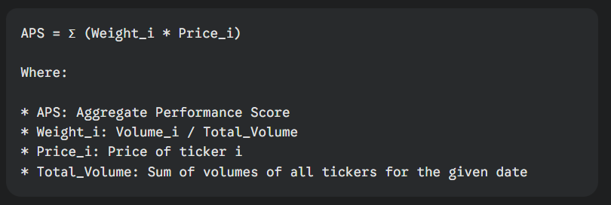
Results and Discussion
Analysing the IT Sector as a whole…

Slide 21
Results and Discussion
Time series analysis methods are statistical techniques used to analyze and forecast time-dependent data.
ARIMA(p, d, q):
p: Order of the autoregressive part
d: Degree of differencing
q: Order of the moving average part
SARIMA(p, d, q)(P, D, Q)s:
P, D, Q: Seasonal autoregressive, differencing, and moving average orders
S: Seasonal period

Slide 22

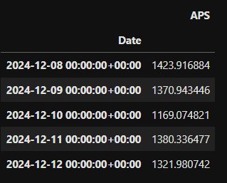
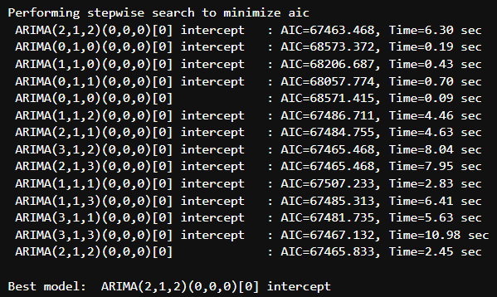
Results and Discussion
ARIMA (AutoRegressive Integrated Moving Average)

Slide 23
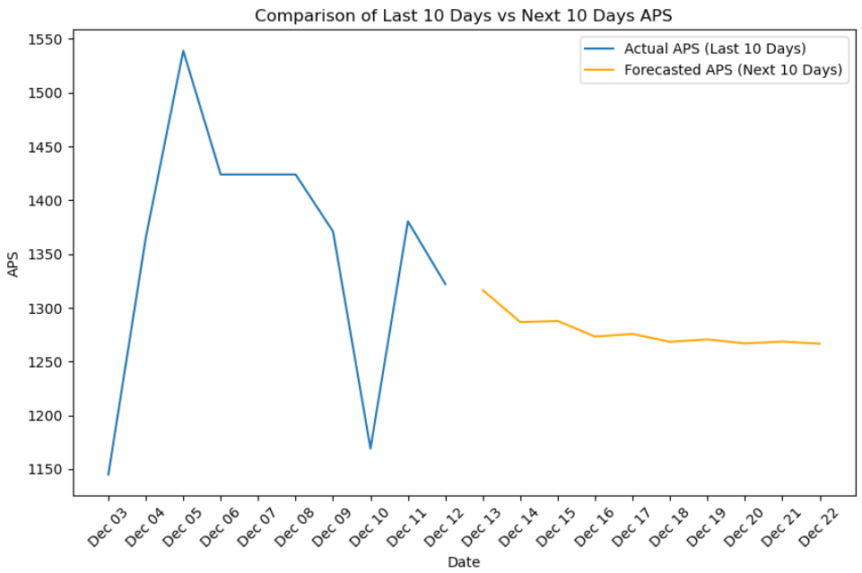
Results and Discussion
ARIMA

Slide 24
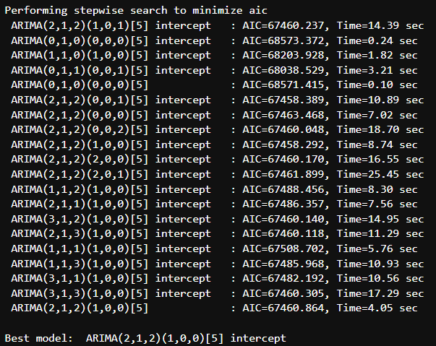
Results and Discussion
SARIMA (Seasonal-ARIMA)

Slide 25
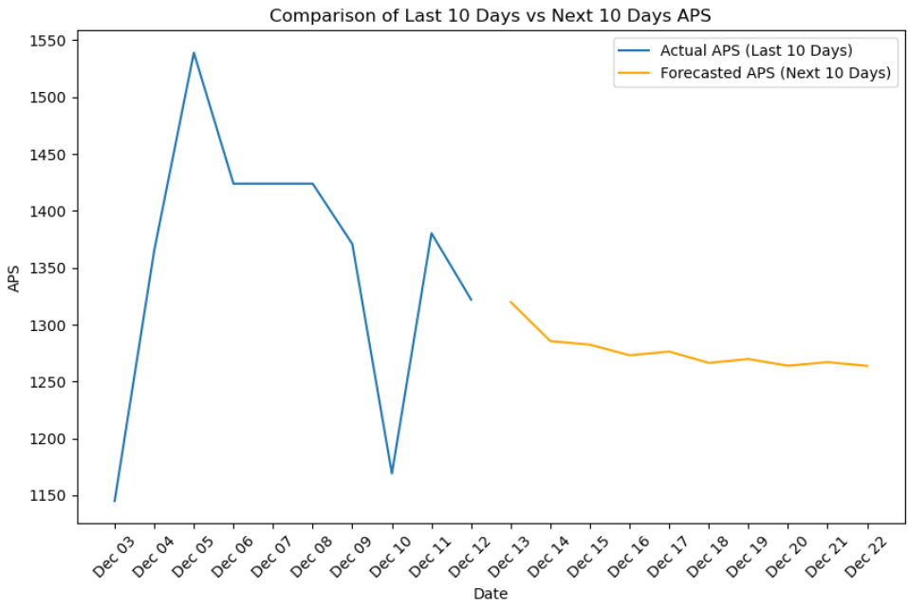
Results and Discussion
SARIMA

Slide 26
Results and Discussion
Recurrent Neural Networks (RNNs) are designed to capture long-term dependencies in sequential data
Key Parameters:
‘units’: number of units in the layer
‘learning_rate’: controls the step size during training
‘batch_size’: number of samples processed before updating the model's weights
‘epochs’: number of times the entire dataset is passed through the model

Slide 27
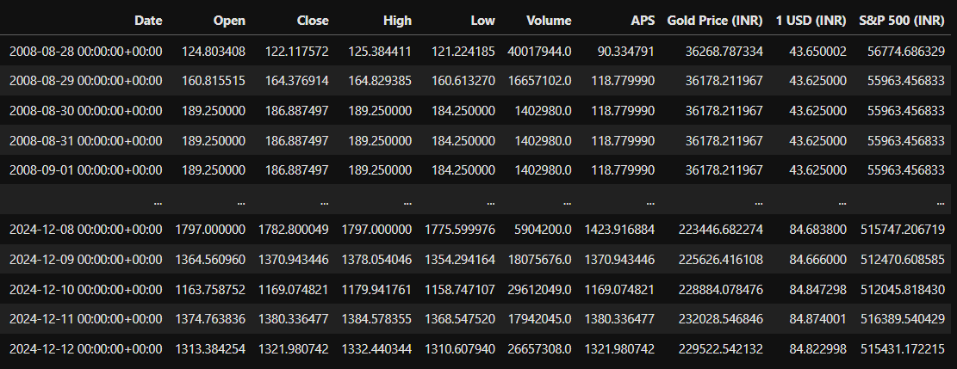
Results and Discussion
GRU (Gated Recurrent Unit)

Slide 28
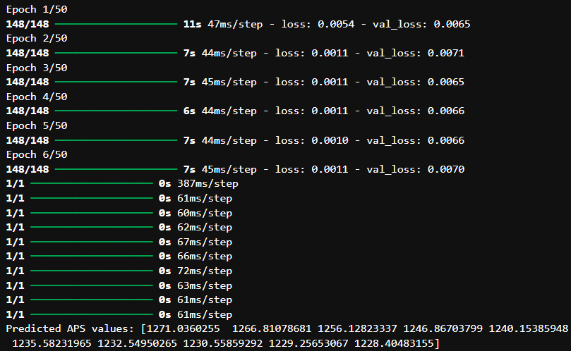
Results and Discussion
GRU

Slide 29
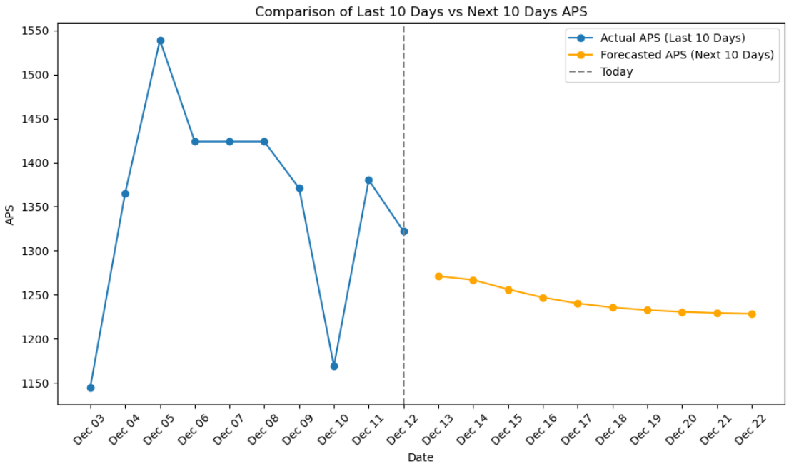
Results and Discussion
GRU

Slide 30
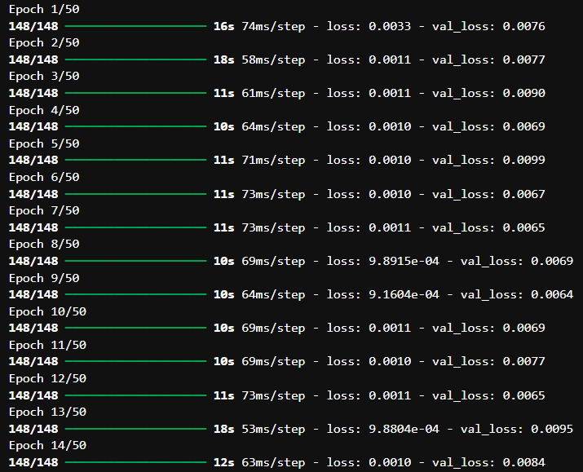
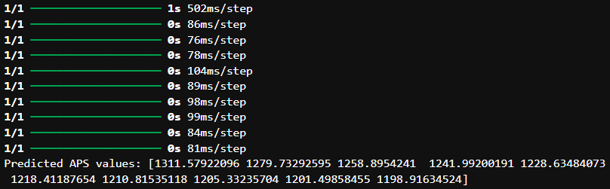
Results and Discussion
LSTM (Long Short-Term Memory)

Slide 31

Results and Discussion
LSTM

Slide 32
Performance Analysis
ARIMA is strictly a time series analysis of one column and for volatile data such as the stock market. Expectedly, it gives a high MSE of 42199.93. SARIMA shows a worse MSE (75829.18) likely due to its overfitting and lack of consistent seasonal patterns in stock market data. Comparatively, GRU performed much better with an MSE score of 18856.15. LSTM fell just short with an MSE score of 20845.25, possibly due to the model’s tendency to overfit due to a higher number of parameters.

Slide 33
Performance Analysis
Model | R-squared | Mean Squared Error
ARIMA | -0.19 | 42199.93
SARIMA | -1.15 | 75829.18
GRU | 0.468 | 18856.15
LSTM | 0.403 | 20845.28

Slide 34
Future Enhancement
In the future, I plan to enhance data quality by exploring alternatives to dropping rows or using methods like forward filling for missing data. Since GRU and LSTM models have shown promise in capturing stock market trends, I aim to fine-tune their hyperparameters to achieve more accurate predictions. From my review of research papers, I discovered that hybridizing these two RNN models can be highly effective, as each has distinct strengths and weaknesses. Additionally, as market sentiment is a stronger indicator of stock price movements than one-dimensional numerical data, I also intend to integrate sentiment-driven analysis into the predictive framework.

Slide 35
Conclusion
Predicting market movements is challenging due to financial data's volatile and non-linear nature. Traditional models like ARIMA and SARIMA struggle with multivariate data and overfitting. However, GRU and LSTM models significantly improve predictive performance by integrating multiple features and leveraging sequential dependencies. These models' flexibility in hyperparameter optimization and handling external influences enables them to capture complex patterns effectively. This project showcases the superiority of RNNs, highlighting their potential for reliable stock market predictions through data preprocessing and model tuning.

Slide 36
References
Base Paper:
Mohan, B., Yadav, A., Toleti, J., Reddy, D. S. S., Ahmed, R. K., & Koushitha, G. (2024). Sentiment-driven predictive models for Nifty 50 stock market fluctuations: A time series analysis perspective. IEEE International Conference on Information Technology, Electronics and Intelligent Communication Systems (ICITEICS), 70, 1–8. https://doi.org/10.1109/iciteics61368.2024.10625537
Link to Paper
Paper I:
Panchal, S. A., Ferdouse, L., & Sultana, A. (2024). Comparative analysis of ARIMA and LSTM models for stock price prediction. 2024 IEEE/ACIS 27th International Conference on Software Engineering, Artificial Intelligence, Networking and Parallel/Distributed Computing (SNPD), 240–244. https://doi.org/10.1109/snpd61259.2024.10673919
Link to Paper
Paper II:
Rajhans, A., Das, T., Kumar, A., & Sinha, B. B. (2024). Exploring the impact of financial news sentiment on stock price forecasting: A comparative deep learning approach. 2024 1st International Conference on Communications and Computer Science (InCCCS). https://doi.org/10.1109/incccs60947.2024.10593315
Link to Paper
Paper III:
Taslim, D. G., Tjahyadi, H., & Murwantara, I. M. (2024). A study of LSTM optimisation for forecasting volatile time series data. 2024 4th International Conference on Computer Communication and Artificial Intelligence (CCAI). https://doi.org/10.1109/ccai61966.2024.10603183
Link to Paper
Paper IV:
Amruth, S. J., Nigelesh, T., Shruthik, V. S., Reddy, V. S., & Venugopalan, M. (2024). Time-series-based stock market analysis using machine learning. 2024 15th International Conference on Computing Communication and Networking Technologies (ICCCNT), 1–7. https://doi.org/10.1109/icccnt61001.2024.10725232
Link to Paper

